Slide 1
ELEMENTARY STATISTICS, BLUMAN
Normal Distribution Example 3
© 2019 McGraw-Hill Education. All rights reserved. Authorized only for instructor use in the classroom. No reproduction or further distribution permitted without the prior written consent of McGraw-Hill Education.

Slide 2
Objectives for this PowerPoint
How to use the standard normal distribution to find a probability associated with a normally distributed random variable.

Slide 3
Example
According to Phys.org, the average fuel economy of vehicles in the US in 2015 was 24.8 mpg. Assume that vehicle fuel economy in the US is normally distributed with a standard deviation of 4.6. Find the probability that a randomly selected vehicle in the US would be rated for fuel economy that is between 15 and 33 mpg.
In probability notation this would be
P(15 < x < 33)
This means the probability that x is between 15 and 33.

Slide 4

Find z score
In order to find this probability we will first have to find the z scores for these values of the random variable.
$$z=\frac{x−μ}{σ}$$
$$z=\frac{15−24.8}{4.6}=−2.13$$
$$z=\frac{33−24.8}{4.6}=1.78$$

Slide 5
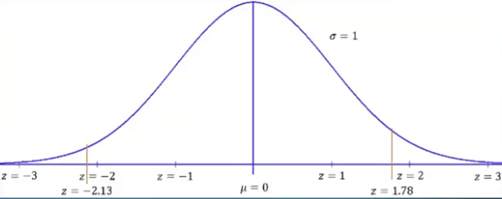
Graph of z scores
A z score of -2.13 would be located just to the left of the z score -2. A z score of 1.78 would be located between the z scores of 1 and 2 a bit closer to 2.

Slide 6
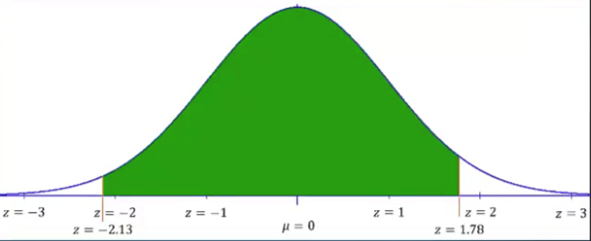
Area Under the Curve
We are to find the probability that a randomly selected value of the random variable would be between those two values. In other words we are looking for this area under the standard normal distribution.

Slide 7
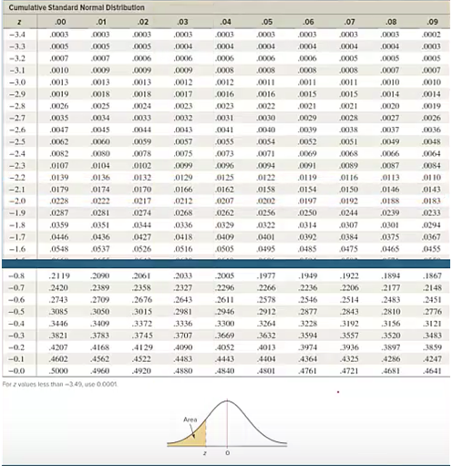
Normal Distribution Table 1

Slide 8

Find area Corresponding to z=-2.13
Look at the left column of the cumulative normal distribution table we travel down until we find a z score of -2.1 and then travel to the right until we find where that row crosses up with the column that is headed .03. We find a value of .0166.
We see at the bottom of this table the picture of the normal distribution.
The 4 decimal place values in the body of the table correspond to the shaded region in the picture of the normal distribution.

Slide 9
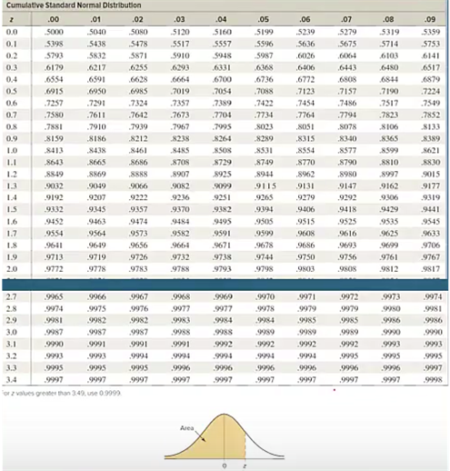
Normal Distribution Table 2

Slide 10

Find area Corresponding to z=1.78
Now find the area to the left of the positive z score that we calculated. Again looking at the left column of the cumulative normal distribution table. We travel down until we find a z score of 1.7 and then travel to the right until we find where that row crosses up with the column that is headed .08. Here we find a value of .9625.
Again at the bottom of this table we see the picture of the normal distribution and the 4 decimal place values in the body of the table correspond to the shaded region in the picture of the normal distribution.

Slide 11
Find Exact Area
In order to find the area shaded we will need to find a difference between 0.9625 and 0.0166.
0.9625 – 0.0166 = 0.9459
The probability that a randomly selected vehicle in the US would be rated for fuel economy that is between 15 and 33 miles per gallon would be 0.9459.
This can also be stated as assuming the average fuel economy of vehicles in the US in 2015 is normally distributed with a mean of 24.8 miles per gallon and a standard deviation of 4.6 miles per gallon. Ninety-four point five nine percent would be rated for fuel economies between 15 and 33 miles per gallon.

Slide 12
Summary
In this PowerPoint we learned how to use the standard normal distribution to find a probability associated with a normally distributed random variable.

